Slide 1

BANK MARKETING ANALYSIS
Akshara Koyyalamudi
Arjun Devineni
Lavanya Cherukuri
Sucharitha Reddy Sura

Slide 2
Term deposit is a fixed-term investment that includes the deposit of money into an account at a financial institution
Significant source of revenue for the institution
Company is having problems determining which kind of consumers are most likely to subscribe to the term-deposit product
Department is facing difficulty in determining how to maximize the success of the current advertising effort
Identifying the characteristics of an individual client, the bank may reasonably forecast whether a certain client will subscribe to a proposed term deposit using machine learning techniques.
Term deposits

Slide 3
Necessity for predicting subscribers
By being able to predict which clients are most likely to subscribe to a term deposit, the Bank can maximize their profits and further diversify their product offering to existing customers which will then improve customer retention.
Also, it would significantly improve both client satisfaction and bank profitability.

Slide 4

Data Collection
Data has been obtained from Kaggle website
https://www.kaggle.com/code/aleksandradeis/bank-marketing-analysis

Slide 5
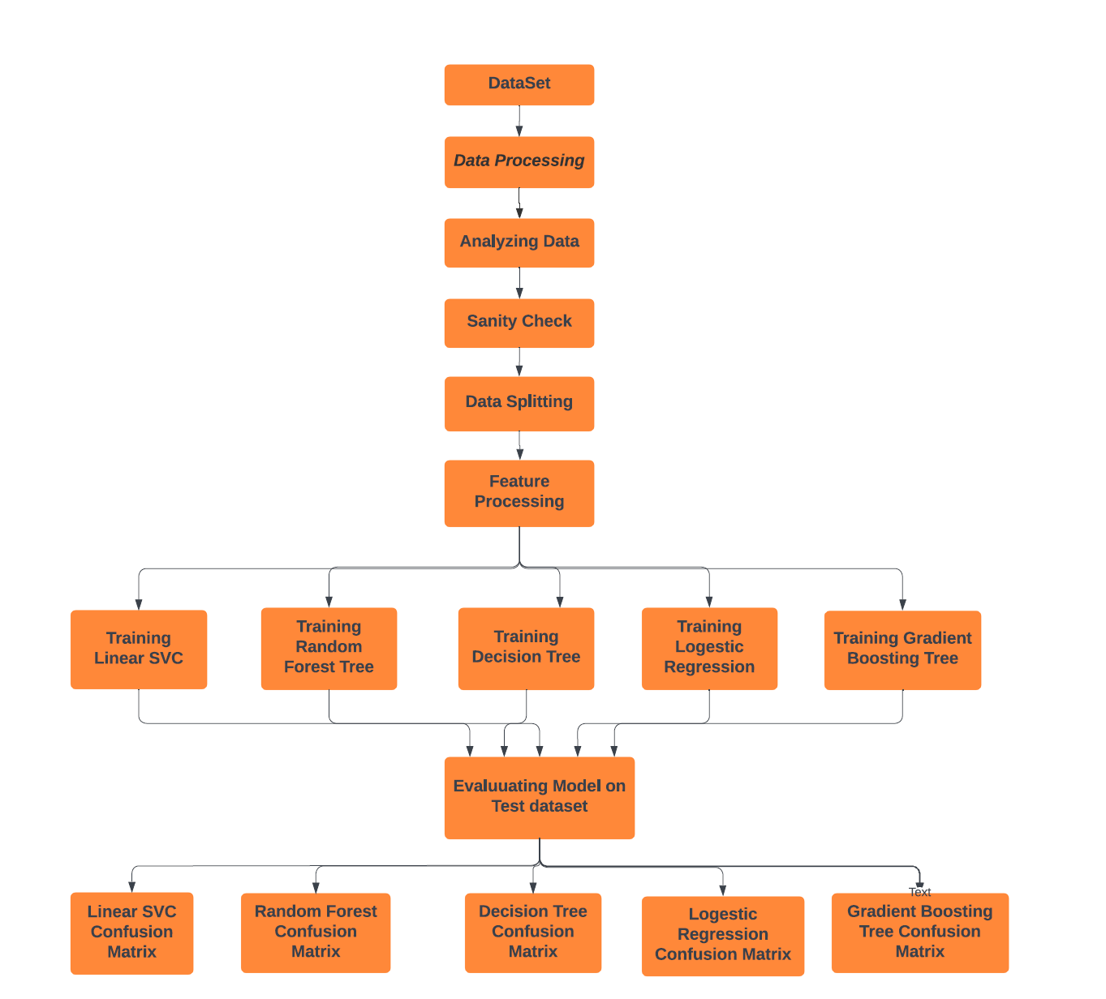
Flow Chart

Slide 6
Data
Preprocessing
Numbers that have been standardized
Categorical columns encoded
Numeric and category columns that have been imputed

Slide 7
Data
Imbalance
We discovered that our dataset was unbalanced after examining it
The distribution of observations in our target Class Y is unequal
To address this imbalance in the data, we used oversampling using existing records (Train dataset)
We created an impartial dataset by employing Oversampling.

Slide 8
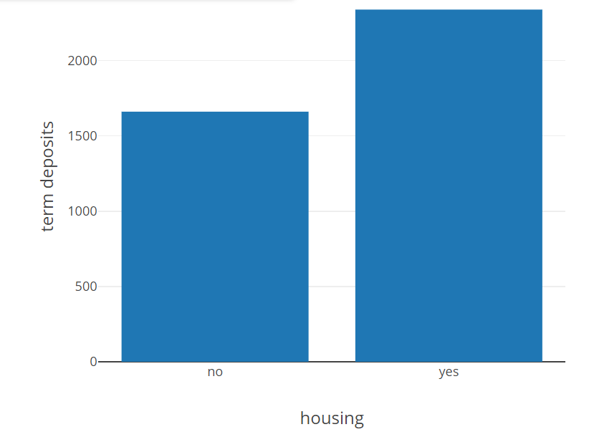
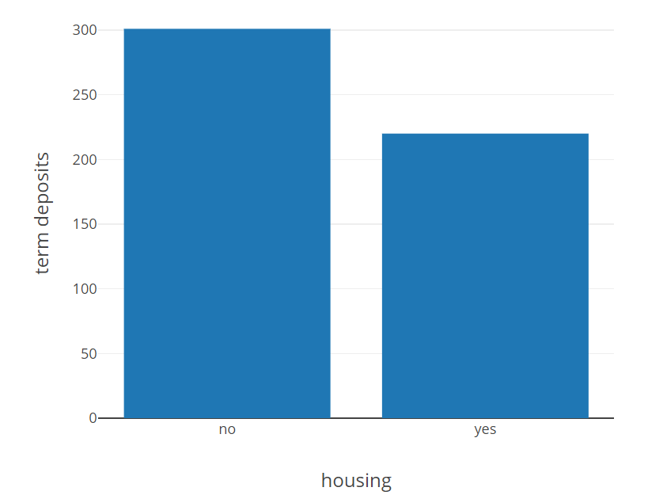
Data Exploratory Analysis on a Processed Dataset
Distribution of people subscribed to term deposit
Distribution of people not subscribed to term deposit

Slide 9
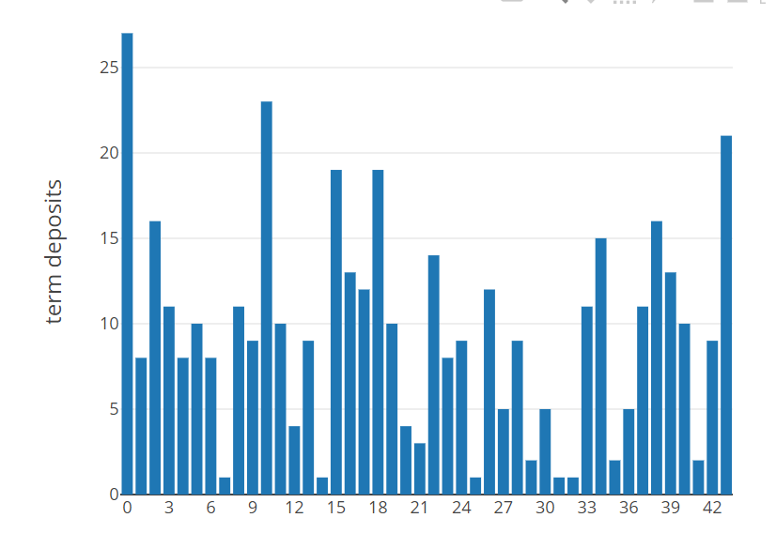
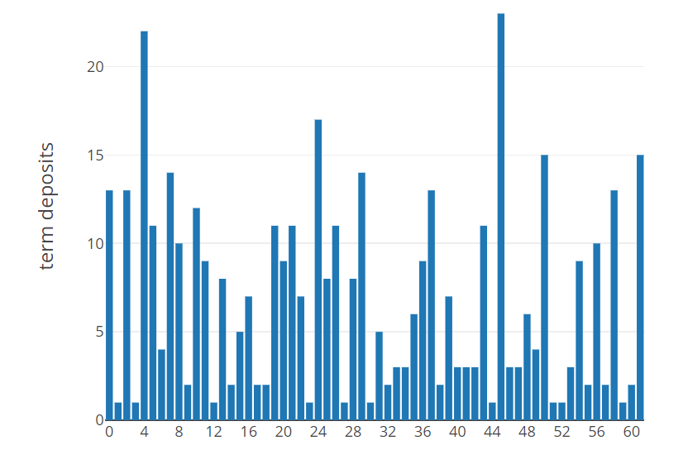
Data Exploratory Analysis on a Processed Dataset
Distribution of people subscribed to term deposit
Distribution of people not subscribed to term deposit
age
age

Slide 10
Logistic Regression
Decision tree
Random Forest Decision Tree
Gradient Boosting Decision Tree
Linear SVC
Models Used

Slide 11
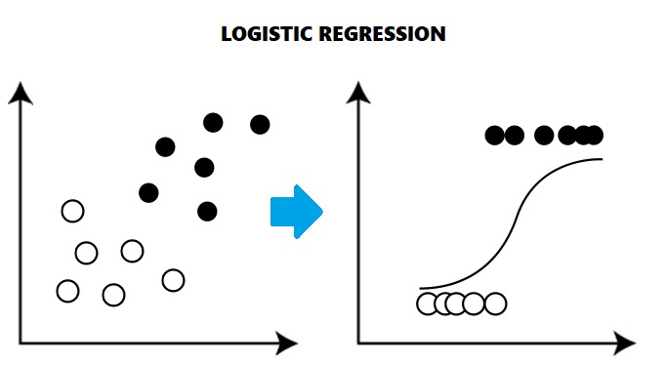
Model Building: Logistic Regression
Logistic regression is a statistical analysis method to predict a binary outcome, such as yes or no, based on prior observations of a data set.
Accuracy : 72.43%

Slide 12
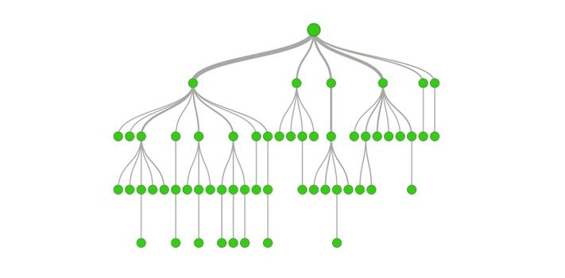
Model Building: Decision Tree
Accuracy : 80.12%
Decision tree analysis is the process of drawing a decision tree, which is a graphical representation of various alternative solutions that are available to solve a given problem to determine the most effective courses of action.

Slide 13
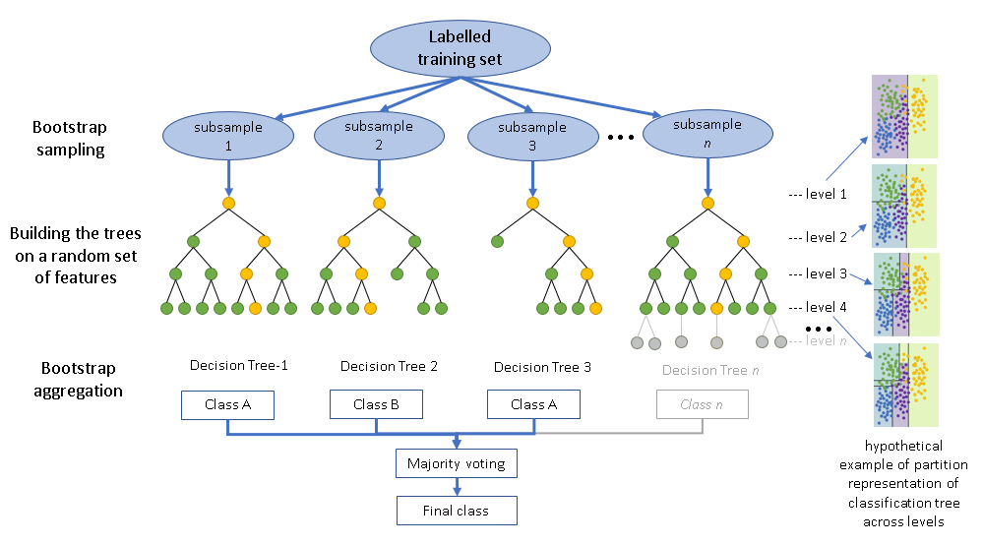
Model Building: Random Forest Decision Tree
Accuracy : 80.44%
Random forests, also known as random choice forests, are a classification ensemble learning approach that works by generating numerous decision trees during training.
For classification problems, the random forest output is the class chosen by the majority of trees.

Slide 14
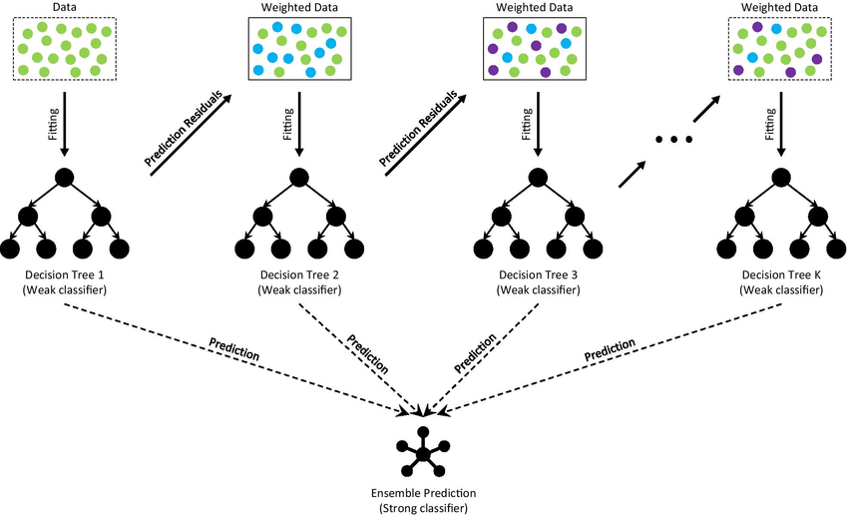
Model Building: Gradient Boosting Decision Tree
Accuracy : 82.58%
Gradient boosting tree is a classification machine learning approach.
It returns a prediction model in the form of an ensemble of weak prediction models, usually decision trees.

Slide 15
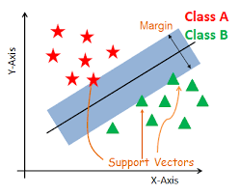
Model Building :
Linear SVC
Accuracy : 83.61%
The objective of a Linear SVC (Support Vector Classifier) is to fit to the data you provide, returning a "best fit" hyperplane that divides, or categorizes, your data.

Slide 16
Models and Accuracy
Baseline Accuracy : 50.1%
Model | Accuracy
Logistic Regression | 72.43%
Decision Tree | 80.12%
Random Forest | 80.44%
Gradient Boosting Tree | 82.58%
Linear SVC | 83.61%

Slide 17
The data processing was difficult because there was a substantial amount of missing data in several columns.
We had to undertake trial and error on incorporating and eliminating numerous features to produce the optimum model, therefore feature selection took a long time.
Challenges faced

Slide 18
To begin, we believe that based on the model's performance, we can stream and automate the process of bank marketing analysis in order to predict whether clients will subscribe to a term deposit or not, which might help banks become profitable.
We believe that 83 percent accuracy is insufficient for real-time deployment, and that we can improve model accuracy by better training our model. We believe that if more data is provided to train the model, it will perform considerably better.
Future works

Slide 19
Thank you!

